Slide 1
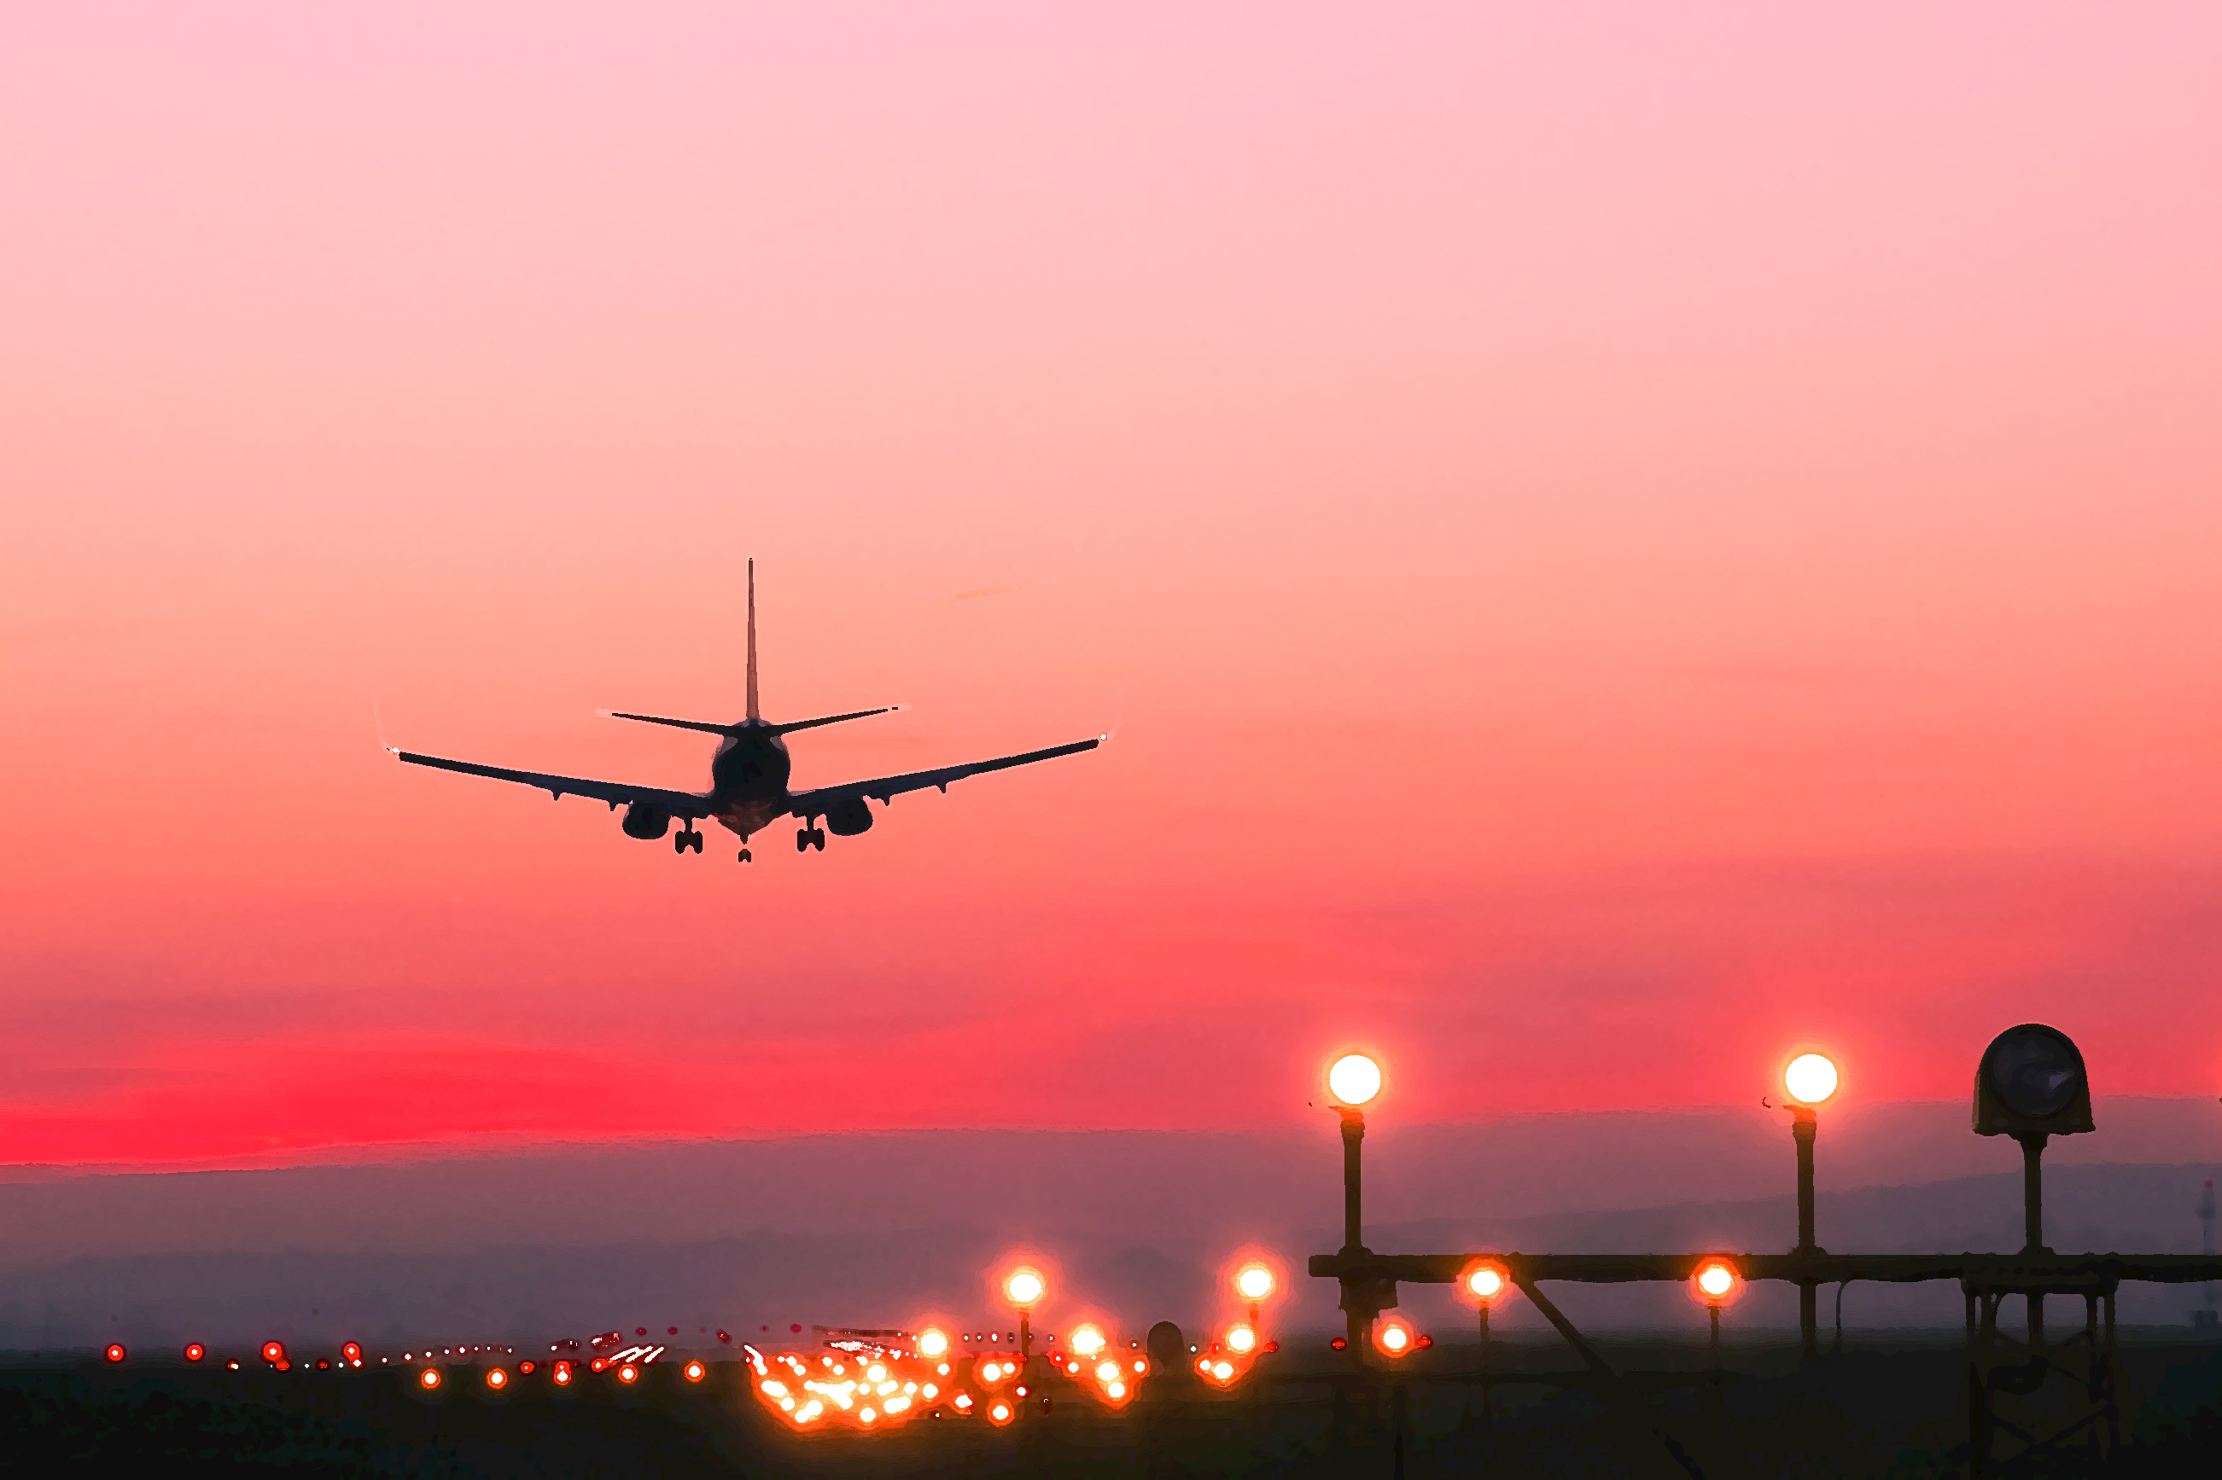
Airline Passenger Satisfaction What factors lead to customer satisfaction for an Airline?
Guangze Wang Kaicheng Zhang
Meng Yang Wanxuan Zhang Zhiyi Zhao
*In alphabetical order

Slide 2
Agenda
Background
Business Problem
Source Data
Data Exploration
Explanatory Data Analysis w/ clustering
Data Cleaning
Feature Mining
Models
Model Selection
Interpretation
Summary
Model Evaluation
Recommendation

Slide 3




Understand the Business Problem
Customer satisfaction is always top of mind for airlines
Total operating revenue streams of U.S. airlines
from 2009 to 2020 (in billion U.S. dollars)
10-Year Stock Performance of Customer Experience(CX)
Leaders vs. Laggards (2011-2020)
U.S. airlines urge to recover from the global pandemic
Airline Customer Experience Leaders Outperform
Dramatic decline due to the coronavirus pandemic
* Source:
Notes:
https://www.panasonic.aero/case-study/increasing-revenue-passenger-satisfaction/
https://watermarkconsult.net/blog/2021/10/18/airline-customer-experience-roi-study/
https://gbr.pepperdine.edu/2010/08/airline-industry-key-success-factors/

Slide 4




Increase Economic Value
Detect unsatisfied flight with high accuracy
Recommend service upgrade
Improve both sales and market share
Understand the Business Problem
Value Of Our Business Case: the big picture
Increase Passenger Satisfaction
Build Customer Loyalty
Achieve Business Success

Slide 5
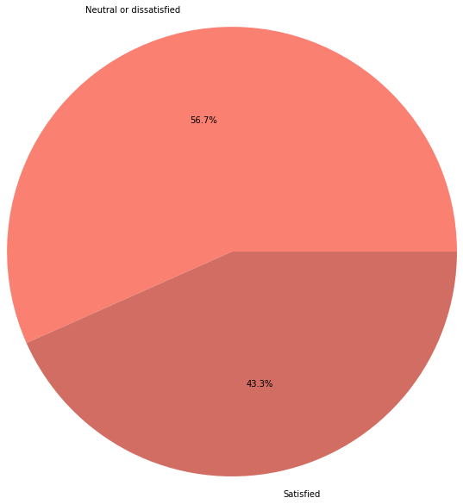
Source data
A relatively balanced dataset with mostly hierarchical categorical features
id | Gender | Customer Type | Age | Type of Travel | Class | Flight Distance | Inflight wifi service | Departure/ Arrival time convenient | Ease of Online booking | ... | Inflight entertainment | On-board service | Leg room service | Baggage handling | Checkin service | Inflight service | Cleanliness | Departure Delay in Minutes | Arrival Delay in Minutes | satisfaction
70172 | Male | Loyal Customer | 13 | Personal Travel | Eco Plus | 460 | 3 | 4 | 3 | ... | 5 | 4 | 3 | 4 | 4 | 5 | 5 | 25 | 18.0 | neutral or dissatisfied
110028 | Female | Loyal Customer | 26 | Business travel | Business | 1142 | 2 | 2 | 2 | ... | 5 | 4 | 3 | 4 | 4 | 4 | 5 | 0 | 0.0 | satisfied
Neutral or dissatisfied (0)
103904 instances
28 features
Train size: 0.8
Test size: 0.2
56.7%
Target variable: satisfaction
# numerical features: 5
# categorical features: 22
43.3%
Satisfied (1)

Slide 6

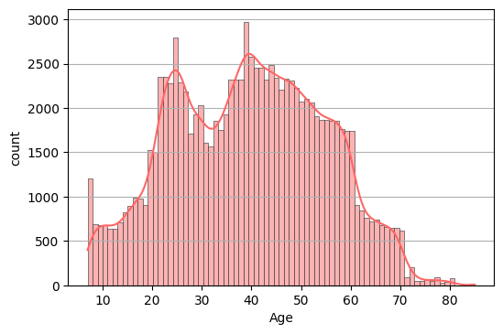
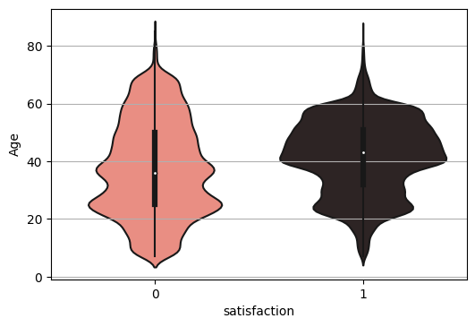
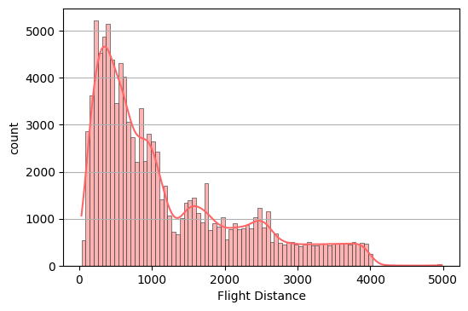
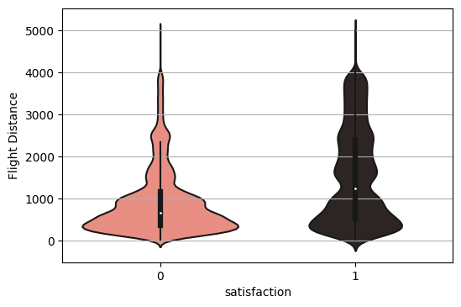
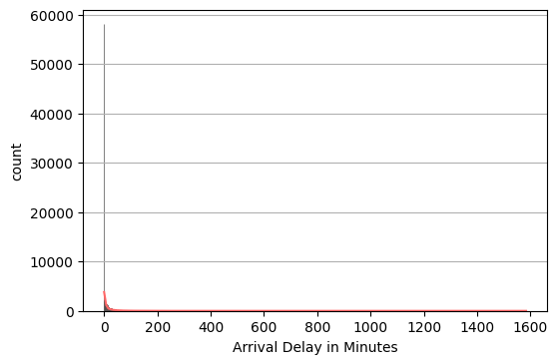
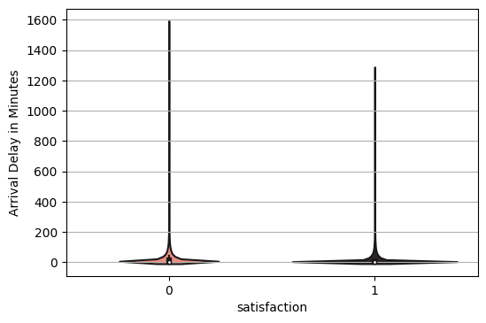
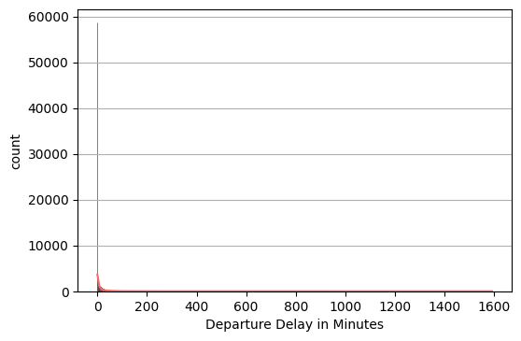
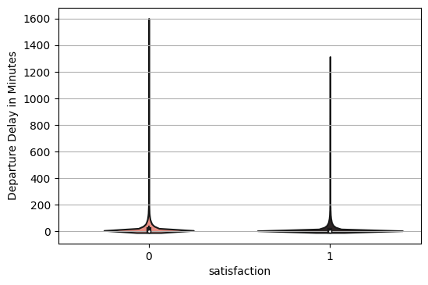
Exploratory data analysis
Numeric features: passenger demographic & flight info
Findings: Middle-aged passengers & Long-distance flight passengers tend to satisfy more.
Age
Flight Distance
Arrival Delay in Minutes
Departure Delay in Minutes
Notes:
middle-aged passengers & Long-distance flight passengers tend to satisfy more

Slide 7
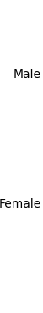
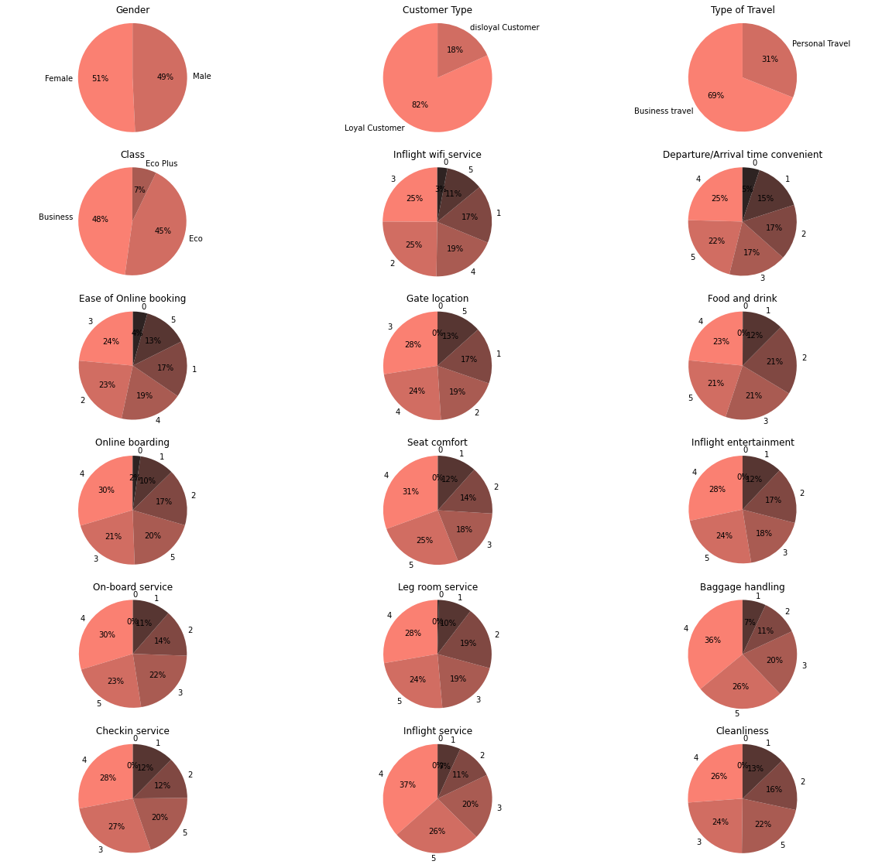
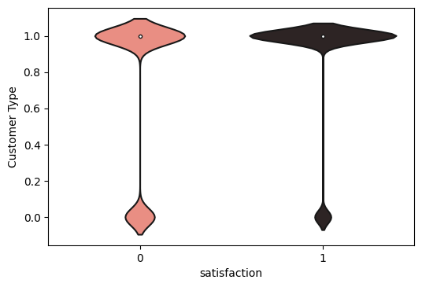
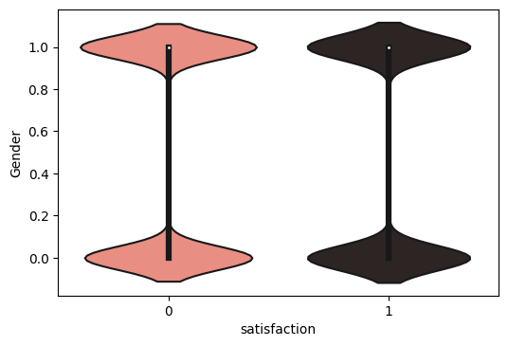
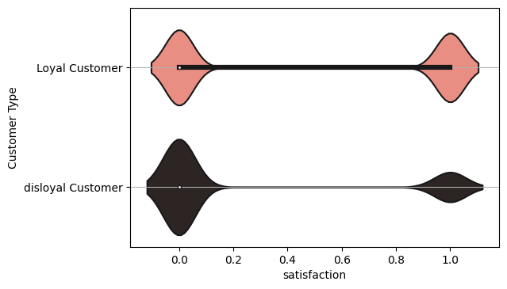
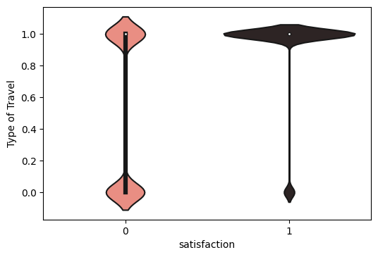
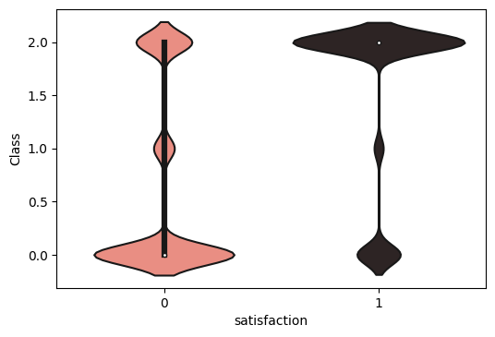
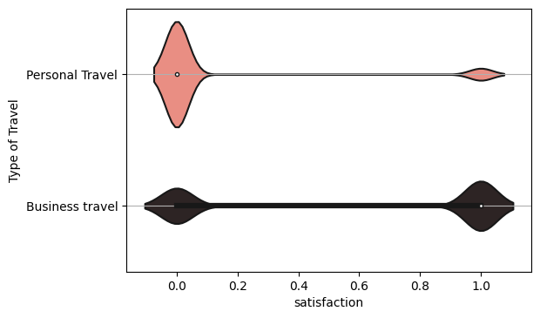
Exploratory data analysis
Categorical features: passenger demographic & flight info
Findings: Loyal customers, business travelers & Business class passengers tend to satisfy more.
Gender
Customer Type
Class
Type of Travel
Business
Eco Plus
Eco
Notes:
Loyal customer, business traveler & Business class passengers tend to satisfy more.

Slide 8
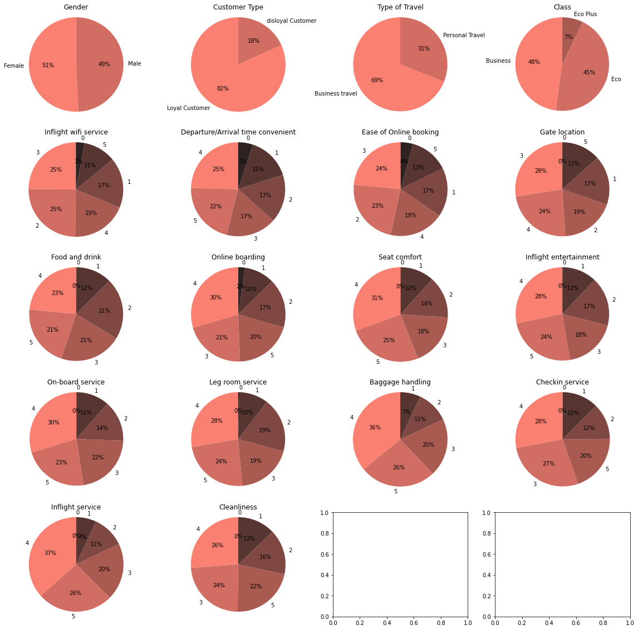
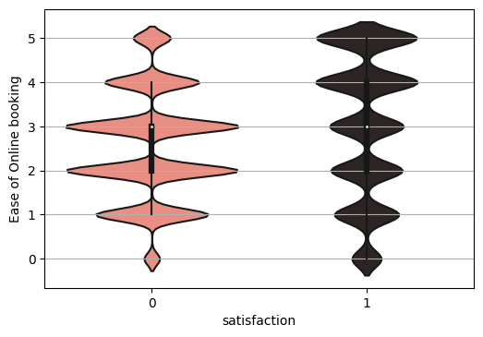
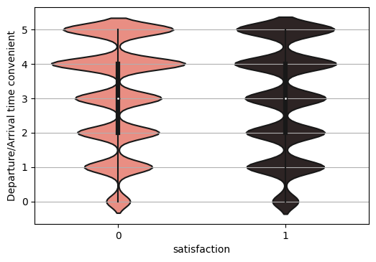
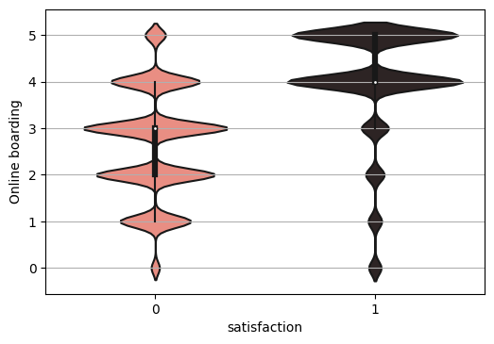
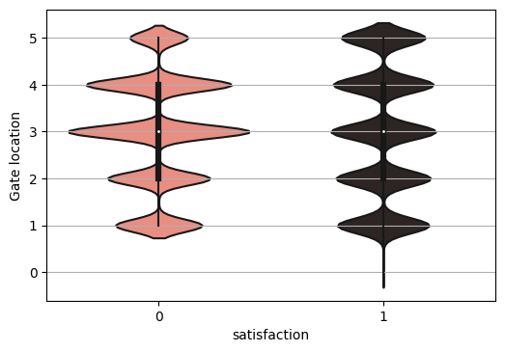
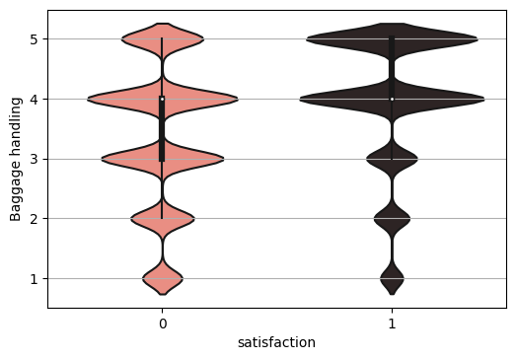
Exploratory data analysis
Hierarchical categorical features: before getting into the plane
Findings: Easier online booking and boarding satisfy passengers more.
Ease of Online booking
Departure/Arrival time convenient
0
Online boarding
0
Baggage handling
Gate location
Notes:
easier online booking and boarding satisfy passengers more.

Slide 9
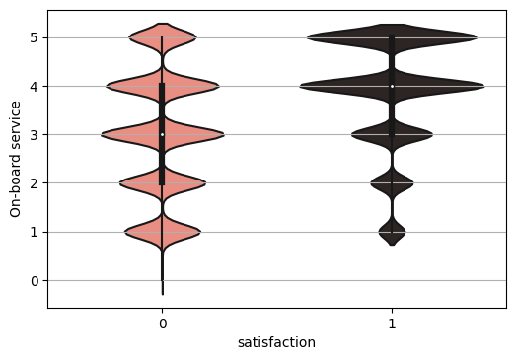

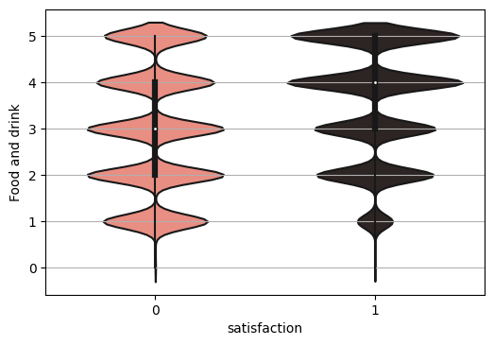
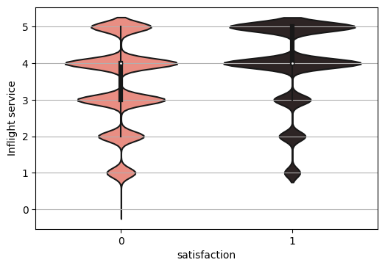
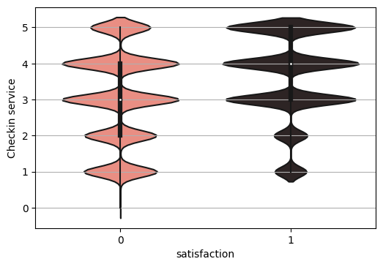
Exploratory data analysis
Hierarchical categorical features: services
Findings: Satisfaction comes more with better services.
On-board service
Leg room service
0
Food and drink
Inflight service
Checkin service
0
0
Notes:
Satisfaction comes more with better services

Slide 10
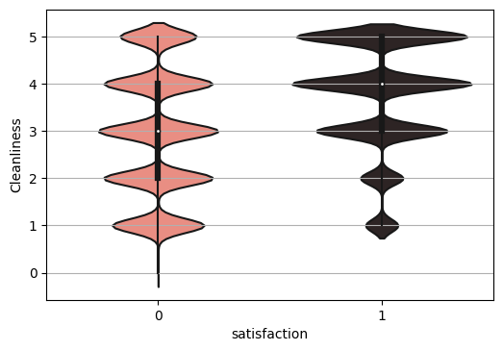
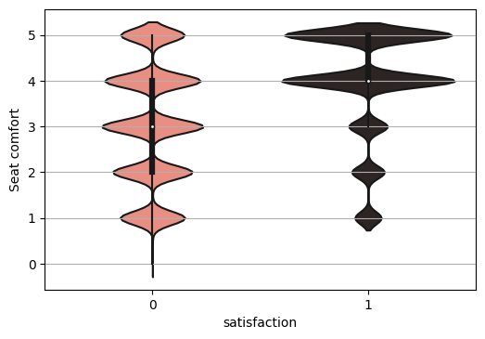
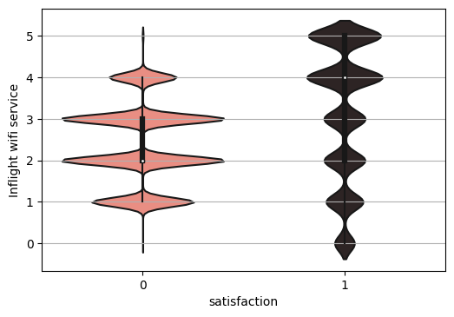
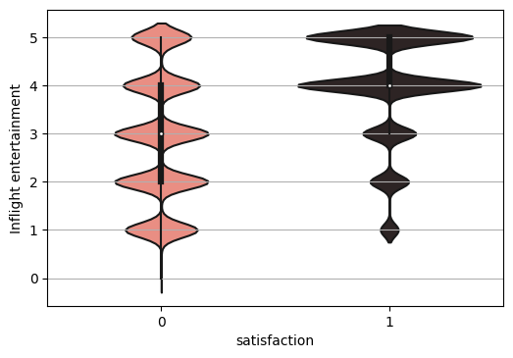
Exploratory data analysis
Hierarchical categorical features: inflight facilities
Findings: satisfaction also comes more with better inflight facilities.
Cleanliness
Seat comfort
Inflight wifi Service
Inflight entertainment
0
0
Notes:
satisfaction also comes more with better inflight facilities, especially wifi service.

Slide 11
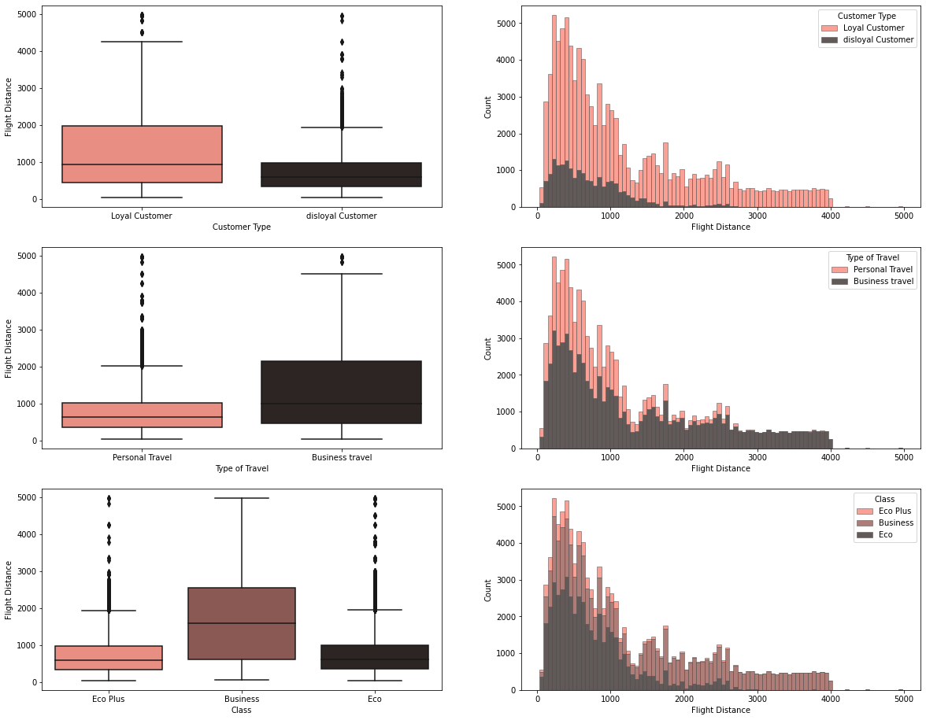
Exploratory data analysis
How flight distance correlate w/ selected features
Findings
Long distance flight passengers are prone to be loyal customers
Long distance flight passengers generally travel for business purposes
Long distance flight passengers tend to buy business class
Notes:
Long distance flight passengers are usually
tend to but business class more

Slide 12
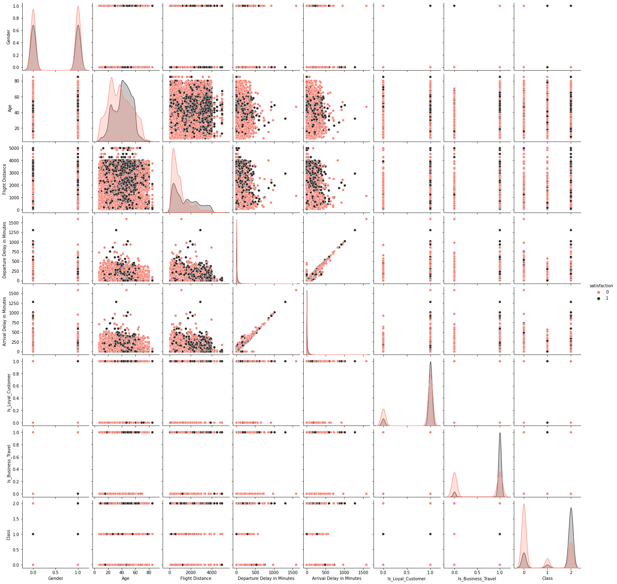
Exploratory data analysis
Clustering – Try Out
Why: Generate different passenger groups to allows us make customized recommendations
What: Clustering is an approach to generate labels and provide insight for feature engineering steps
How: lessons learned in the process
The involvement of Binary or Categorical predictors would make clustering useless
Using the combination of numerical predictors is the prerequisite
It’s necessary to check scatterplots for understanding the data before applyting clustering

Slide 13
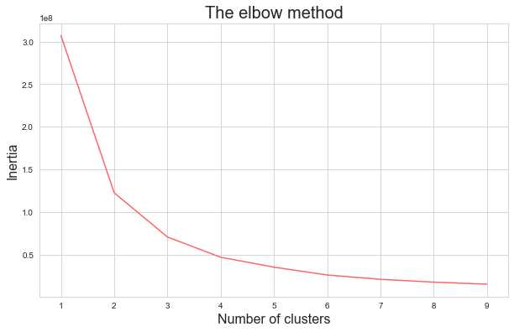
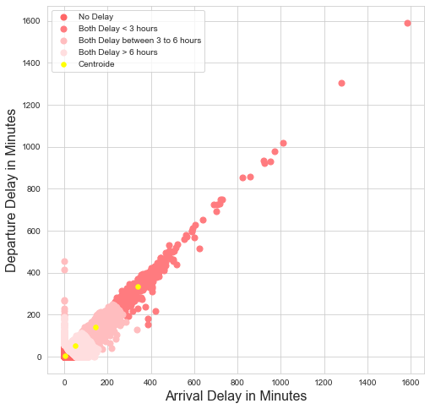
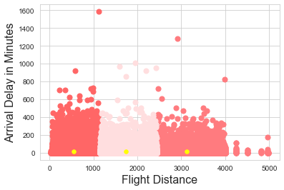
Exploratory data analysis
Clustering – Result
Notes:
Explain how the logic of clustering, and why it didn’t work.
At the end, infer that we would generate labels manually later on

Slide 14
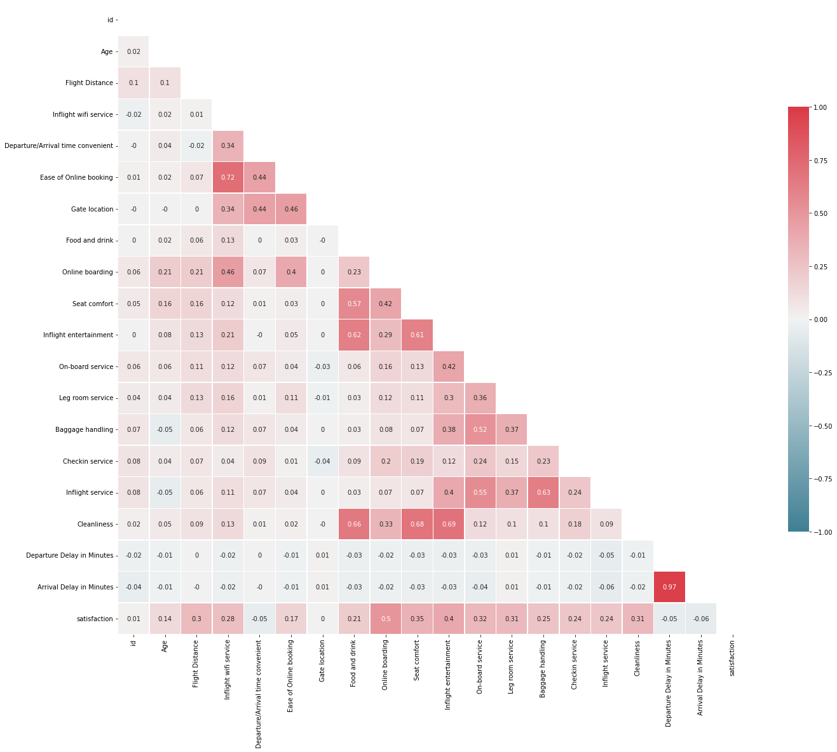


Feature Mining
Data cleaning & engineering
Cleaning
Drop id, Gate location, Departure/Arrival time convenient due to low correlation
Drop Arrival Delay in Minutes due to its high correlation with Departure Delay in Minutes and missing values
Engineering
Creating categorical features using clustering info
& examining their correlation with satisfaction
 | is_dep_delay | is_arr_delay | is_delay | delay_clusters | is_longdist | Flight Distance
satisfaction | -0.07 | -0.09 | -0.07 | -0.07 | 0.28 | 0.3
Notes:
Among all predictors, Online boarding and Inflight entertainment are highly correlated with satisfaction.
Id, Departure/Arrival time convenient, Departure/Arrival Delay in Minutes, Gate location have relatively low correlation

Slide 15

Model Selection
Tree based & other models
Tree Based Models: Decision Tree, Random Forest, AdaBoost, Gradient Boosting, Light GBM, XGBoost
Other Models: Gaussian Naïve Bayes, K-Nearest Neighbors, Support Vector Machine, Logistic Regression,
Stochastic Gradient Descent
Rank | Model | Accuracy | F1 Score
1 | Light GBM | 96.28 | 95.63
2 | Random Forest | 96.24 | 95.6
3 | XGBoost | 96.16 | 95.5
4 | Decision Tree | 94.53 | 93.72
5 | Gradient Boosting | 94.01 | 93.01
6 | KNN | 93.6 | 92.44
7 | AdaBoost | 92.41 | 91.21
8 | Logistic Regression | 87.57 | 85.45
9 | SGD | 87.35 | 84.19
10 | Linear SVM | 87.3 | 85.21
11 | Naive Bayes | 85.29 | 82.97

Slide 16

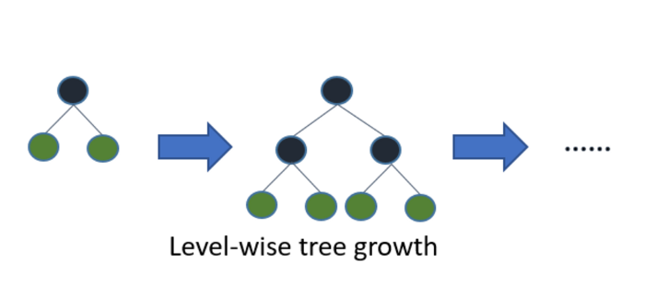

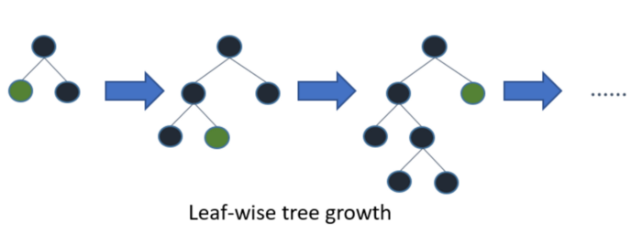


Light Gradient Boosting Machine (LightGBM)
Our final model
Supervised Machine Learning
A gradient boosting framework that uses a tree-based algorithm
Reduce complexity
Gradient based one side sampling
Exclusive feature bundling
Histogram based splits
Pros
Faster training speed and higher efficiency
Better accuracy
Lower memory usage
Support of parallel, distributed, and GPU learning
Capable of handling large-scale data
Cons
Overfitting
Compatibility with Datasets
Success Metrics:
Confusion Matrix
Classification Report with Precision, Recall, F1 score
Notes:
One-Side Sampling (GOSS): Uses only the data points with larger gradients to estimate information gain (obtaining an accurate estimation of information gain while using fewer observations. This makes it lighter — ergo its name: LightGBM). Terminology alert! we define gradient as the negative derivative of the loss function we try to minimize.
Exclusive Feature Bundling (EFB): Bundle together features that seldom present non-zero values for the same observation (example: one-hot encoding).
Histogram based splits: Uses a more efficient histogram-based binning strategy to find the split points in the data. This also makes it faster than regular gradient boosting algorithms.
Advantages of Light GBM
Faster training speed and higher efficiency: Light GBM uses a histogram-based algorithm i.e it buckets continuous feature values into discrete bins which fasten the training procedure.
Lower memory usage: Replaces continuous values to discrete bins which results in lower memory usage.
Better accuracy than any other boosting algorithm: It produces much more complex trees by following leaf wise split approach rather than a level-wise approach which is the main factor in achieving higher accuracy.
Compatibility with Large Datasets: It is capable of performing equally well with large datasets with a significant reduction in training time as compared to XGBoost.
Disadvantages of Light GBM
Overfitting: Light GBM split the tree leaf-wise which can lead to overfitting as it produces much complex trees.
Compatibility with Datasets: Light GBM is sensitive to overfitting and thus can easily overfit small data.

Slide 17
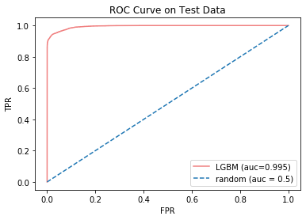
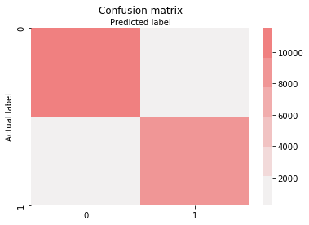
Model performance
Success metrics w/ our final model: Light GBM
Hyper-parameters tuning using cross-validation
Maximum tree depth: 8
Minimum children samples: 18
Minimum children weight: 0.001
Number of leaves: 40
11541
229
Classification Report
 | Precision | Recall | F1 Score | Accuracy
0 | 0.95 | 0.98 | 0.97
1 | 0.97 | 0.94 | 0.96
overall |  |  |  | 0.96
551
8460
Notes:
Explain the difference of precision and recall
# Precision (FPR): actually unsatisfied, but predict as satisfied
# Recall (FNR): actually satisfied, but predict as unsatisfied

Slide 18
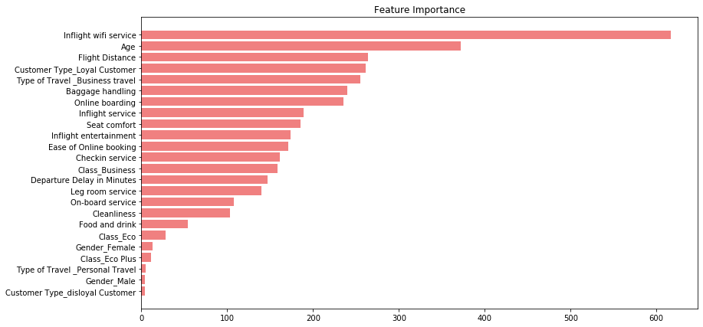


Model performance
Feature importance w/ Light GBM
Top 5 Features | Top 5 Features
1 | Inflight wifi service
2 | Age
3 | Flight Distance
4 | Customer Type
5 | Type of Travel
Top 5 upgradeable features | Top 5 Features
1 | Inflight wifi service
2 | Baggage handling
3 | Online boarding
4 | Inflight service
5 | Seat comfort
Notes:
We find the top 5 upgradable features

Slide 19
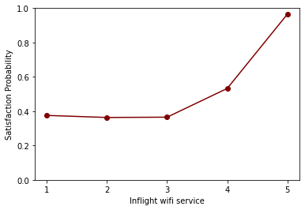
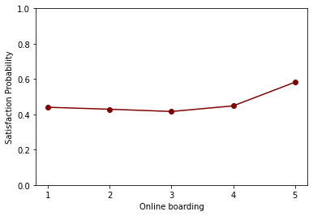




Feature predictions (Partial Dependence Plot)
How much can changing feature values improve satisfaction in probability?
Inflight wifi Service
Online boarding
Seat comfort
Improve by 0.6
Improve by 0.14
Improve by 0.07
Notes:
Explain the calculation of pdp
1. Replace wifi service in the entire dataset as fixed value
2. put the dataset into the model, get predictions for all the data and take the average
3. repeat this for all unique values of wifi service and get the plot

Slide 20
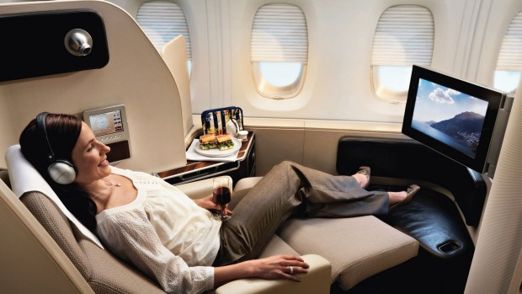



Interpretation
Differentiating customers
Example:
Type of Travel
Business
Non-Business
Frequent Passenger - High value customer, given we assume business travels and loyalty passengers would use our service most frequently | Loyal Traveler - Our main supporters, should constantly observe their feedback to make sure no churn
Frequent Newcomer - Potential high value customers, should attract them | Mobile Traveler - Travelers don’t care about which airline, no need further operation
True
We intend to generate labels for passengers based on objective features
Differentiation allows us to make customized recommendations:
Pools
Gender, Age, Flight Distance, Loyalty, Type of Travel, Class
Selection
Loyalty
Type of Travel
Class
Loyalty
False
Notes:
Given Clustering didn’t help generate intuitive labels, we decided to generate labels manually
We want generate labels that have business meanings, and can be interpret differently from our model. (Business Meaning as the start-off point)
We don’t want to discriminate based on gender and age (not using them to define business value); flight distance is a variable that we can hardly influence upon
‘Loyalty’, ‘Is Business Travel’, ‘Class’ are suitable to define customer value and can help reveal some of the customer personas. We take the combination of them to differentiate customers
* Ordinary travelers have more population than business passengers; business passengers fly more frequently compared to travelers.

Slide 21
Interpretation
Loyalty/Class
Customer Type |  | Inflight wifi service | Baggage handling | Online boarding | Inflight service | Seat comfort | Satisfaction
Economy | non-Loyal | 2.58 | 3.37 | 2.59 | 3.38 | 3 | 0.14
+ Economy | Loyal | 2.7 | 3.47 | 2.88 | 3.49 | 3.18 | 0.2
Economy Plus | non-Loyal | 2.46 | 3.14 | 2.47 | 3.15 | 3.02 | 0.08
+ Economy Plus | Loyal | 2.8 | 3.39 | 2.93 | 3.41 | 3.2 | 0.26
Business | non-loyal | 2.93 | 4.22 | 2.91 | 4.22 | 2.99 | 0.4
+ Business Class | Loyal | 2.75 | 3.78 | 3.86 | 3.78 | 3.9 | 0.75
Findings
Loyal Business Class passengers aren’t satisfied with inflight wifi service
Non-Loyal Business Class passengers aren’t satisfied with seat comfort
Nearly no group is satisfied with the existing inflight wifi service
Notes:
Loyal Business Class passengers are our prime and high value customers, but they aren’t satisfy enough with inflight wifi service (comparing horizontally and vertically)
Non-loyal Business Class passengers aren’t satisfy with seat comfort. These people may potentially have more exposure to the business class in various airlines. In order to attract these potential high value customers, given they are ‘rich’, we need to consider improving the seat comfort
Potential Issue: our wifi network is slow, our wifi network is expensive, we don’t have wifi service

Slide 22
Interpretation
Type of Travel/Class
Customer Type |  | Inflight wifi service | Baggage handling | Online boarding | Inflight service | Seat comfort | Satisfaction
non-Business Travel | Economy | 2.52 | 3.6 | 2.77 | 3.62 | 3.17 | 0.1
non-Business Travel + | Economy Plus | 2.5 | 3.57 | 2.76 | 3.62 | 3.21 | 0.09
non-Business Travel + | Business Class | 2.55 | 3.34 | 3.24 | 3.33 | 3.46 | 0.12
Business Travel | Economy | 2.88 | 3.26 | 2.87 | 3.26 | 3.1 | 0.3
Business Travel + | Economy Plus | 3.01 | 3.17 | 3.01 | 3.17 | 3.16 | 0.39
Business Travel + | Business Class | 2.79 | 3.87 | 3.74 | 3.87 | 3.77 | 0.72
Findings
Business Travel who also booked business class might potentially care about working in flights, poor inflight wifi service would be a huge CON for their overall experience
Notes:
Assumption: Business Travel passengers fly more frequent compared with non-business travel.
(No other findings)

Slide 23
Interpretation
Type of Travel/Loyalty
Customer Type |  | Inflight wifi service | Baggage handling | Online boarding | Inflight service | Seat comfort | Satisfaction
non-Business Travel | non-Loyal Customer | 2.63 | 3.73 | 2.48 | 3.78 | 2.98 | 0.16
Non Business Travel + | Loyal Customer | 2.52 | 3.58 | 2.8 | 3.6 | 3.2 | 0.1
Business Travel | non-Loyal Customer | 2.71 | 3.69 | 2.71 | 3.7 | 2.99 | 0.24
Business Travel + | Loyal Customer | 2.86 | 3.64 | 3.72 | 3.64 | 3.75 | 0.71
Findings
Baggage Handling and Inflight service are exceptional
Online Boarding is not satisfying the majority groups
Notes:
Business Travel + Loyal Customer are the group of people who fly the most (Btravel > not Btravel, Loyal customer > non-loyal customer), indicating they are familiar with the online boarding process the most.
However, for other groups, the onlien boarding rating are all low, meaning our online boarding process might be too complicate, need to resolve accessbility issue.

Slide 24
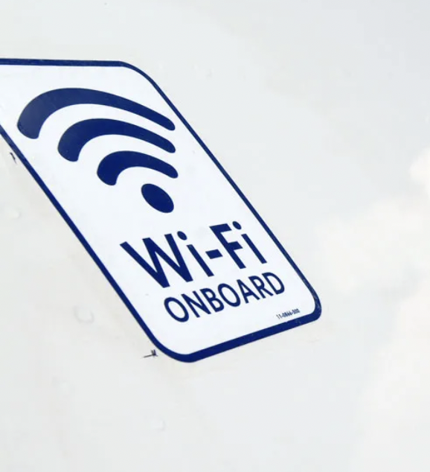
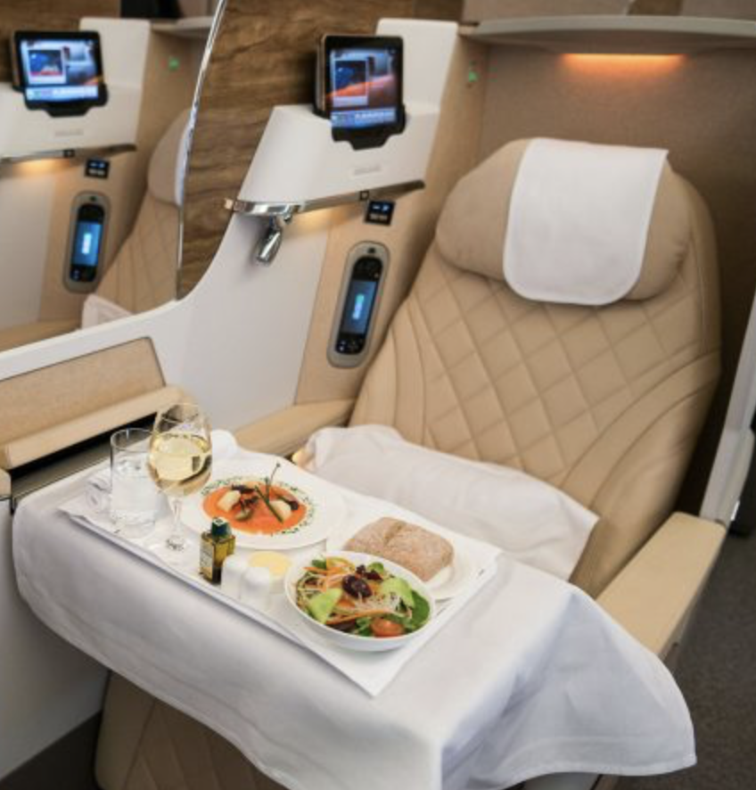
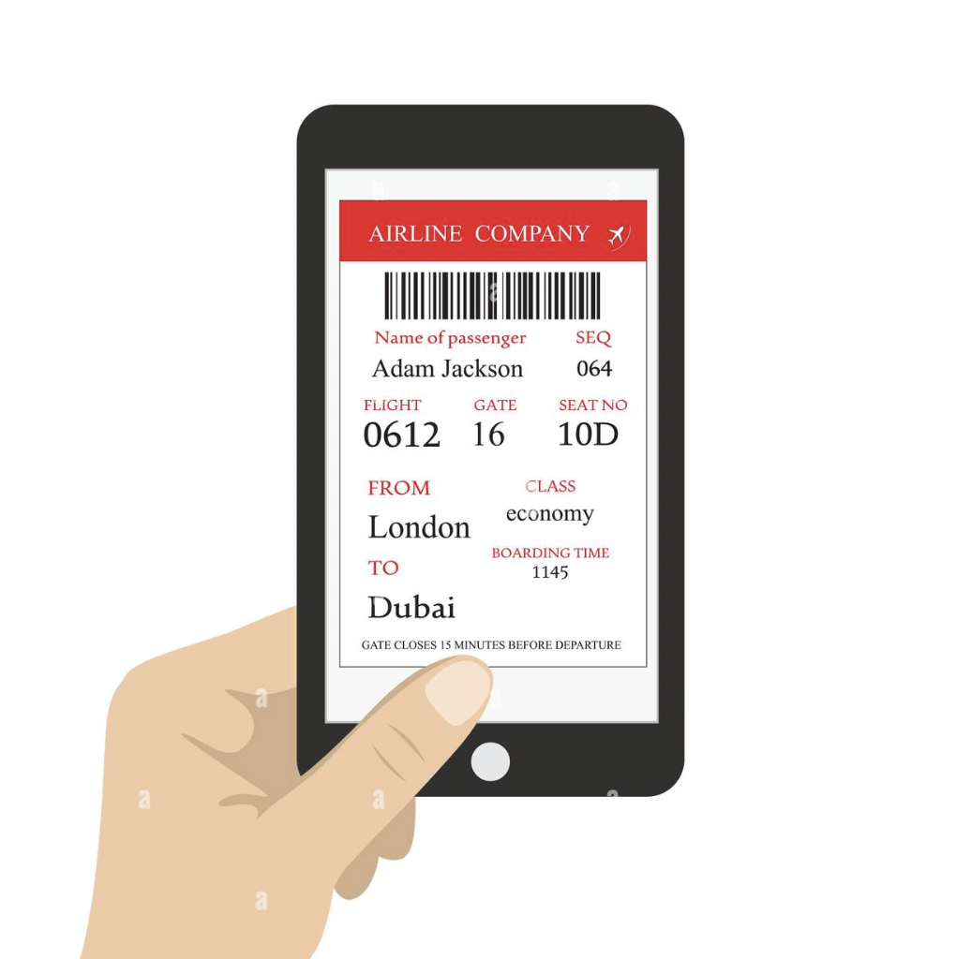
Recommendation
Potential area of improvement
Inflight Wifi service
Seat Comfort
Online Boarding
Notes:
Inflight wifi service is a must
Seat comfort (especially in business class)
Online boarding (accessibility, and ease of use issue)
*This correspond with the finding in the features prediction section

Slide 25

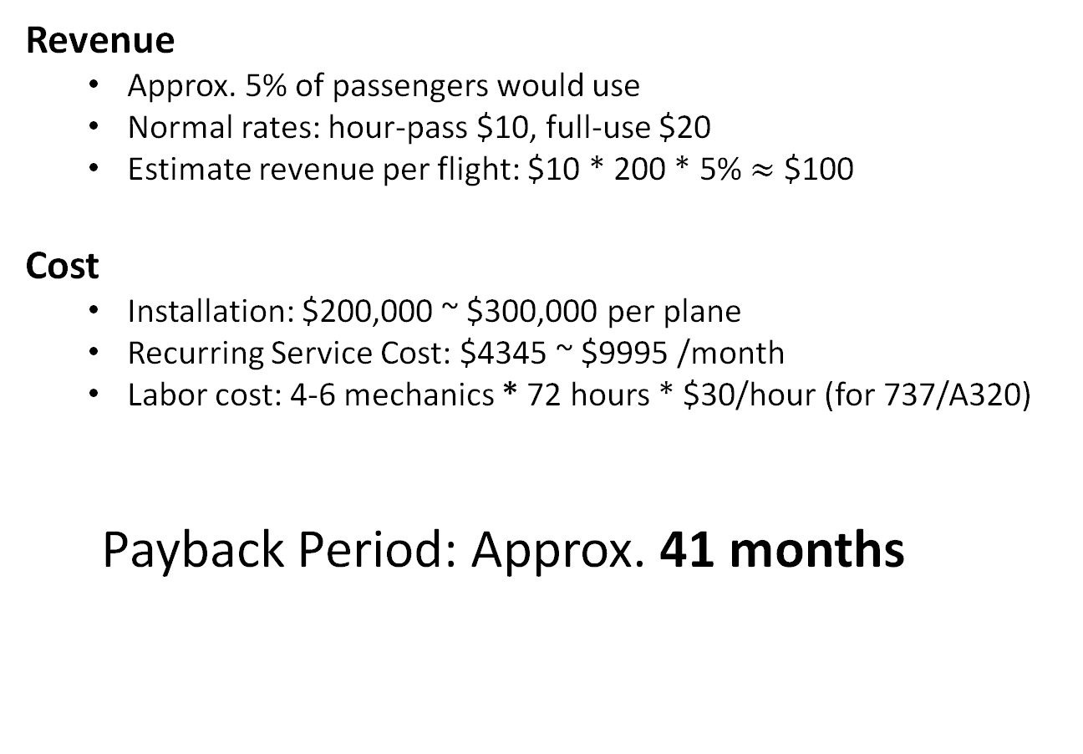
Recommendation
Analysis on Inflight Wifi Service
Revenue
Approx. 5% of passengers would use
Normal rates: hour-pass $10, full-use $20
Estimate revenue per flight: $10 * 200 * 5% $≈$ $100
Cost
Installation: $200,000 ~ $300,000 per plane
Recurring Service Cost: $4345 ~ $9995 /month
Labor cost: 4-6 mechanics * 72 hours * $30/hour (for 737/A320)
Payback Period: Approx. 41 months
Notes:
*normal 2-hour flight aircraft may fly for 4 times a day. $400 wifi revenue per day * 30 = $12000 month
Revenue per month $12000 - $4345 = $7615 .($300,000+$12,960 labor)/$7615 = 41 months
* labor rate at repair station or airline: $30
https://www.phocuswire.com/What-s-the-cost-of-equipping-a-plane-with-wifi
https://www.airliners.net/forum/viewtopic.php?t=1405523
https://upgradedpoints.com/travel/airlines/how-airplane-wi-fi-works/
https://business.gogoair.com/how-to-buy/data-voice-plans/

Slide 26

Recommendation
Analysis on Seat Comfort
Production Cost
$3000 ~ $5000 per economy class seat; $10000 for long flights
$30000 ~ $80000 per business class seat
* World most popular plane (Boeing 737-800: 189 economy seats occupancy)
Design and Installation
New seat designment is the stage that takes most of the time
Hard for groundbreaking improvement
Estimated Production Cost: $1,890,000
Notes:
Calculate per seat upgrade cost * #of upgrade seats = total cost (even if we consider all seats as economy class, the cost would be $10,000 * 189 = $1,890,000)
Cost of production better seats is high, let alone wasted money on replacing old ones, and let alone whether upgrade seats can really be reflected from customers’ feedback.
Design:
Intstallation process took short period of time, but the design is where huge time investment needed. A absolute new design and production of seat can take up to 3 years. (Let alone cost of hiring designers)
Most of today’s seats are about as effective in possible, because they’re an efficient use of space ---- hard for groundbreaking improvement
According to an airline seat production company, the most possible advancement for airplane seat is the armrest. (But how will that adjustment make huge impact)
https://aerocorner.com/blog/why-are-planes-so-expensive/
https://www.businessinsider.com/a-business-class-seat-costs-80000-2013-8
https://skift.com/2017/06/28/designing-an-airline-seat-from-scratch-is-not-as-easy-as-it-looks/

Slide 27
Recommendation
Analysis on Online Boarding
Software Development is the key
Time:
30 days for building up an application from scratch
2 to 3 weeks at most for version update
Labor:
A team of 5 including project manager and CS engineers
Cost:
Software Development:
5 people * 30 days * 8 hours/day * $50/hour = $60,000
Total Cost: $100,000 (development + maintenance)
Notes:
Normally an ariline company will just need upgrade and adjustment of its existing app, which will cost even less
https://zhuanlan.zhihu.com/p/409077232

Slide 28


Recommendation
Summary
Inflight Wifi Service
Seat Comfort
Online Boarding
Notes:
Discuss from a “cost of implementation and impact” perspectives
Cost of Implementaion: online boarding > inflight wifi > seat comfort
Impact: Inflight wifi > seat comfort > online boarding
Overall: suggestion inflight wifi, online boarding, not recommennd seat comfort

Slide 29
Q & A

